Slide 1

Non-Inferiority Margins in Clinical Trials.
Difficult but necessary, or just a waste of time?
Dr Simon Day
Roche Products Ltd
simon.day@Roche.com

Slide 2
A description of the problem
Consider a model where y_{ij}~N(μ_{i},σ²)
Not a very helpful starting position(!)

Slide 3
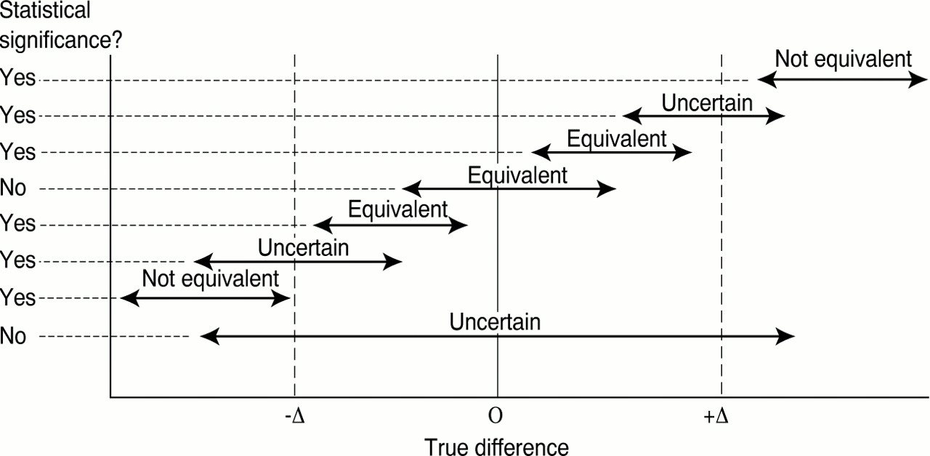
A description of the problem
Jones, B et al. BMJ 1996;313:36-39
But is this any better?
Copyright ©1996 BMJ Publishing Group Ltd.

Slide 4
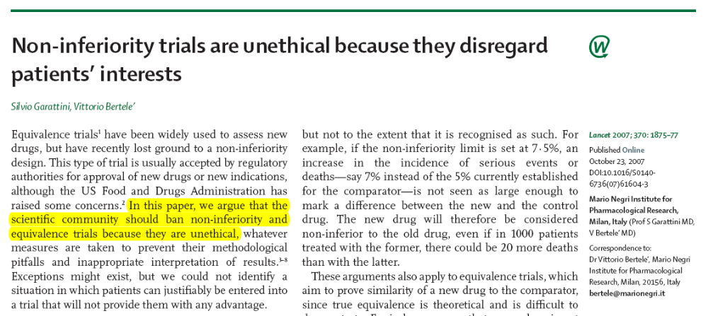
Non-inferiority trials have no place

Slide 5
Ethics is a broad subject
It may not seem unethical to recruit patients into a trial provided they will not be disadvantaged…
But what about the expense, inconvenience and use of their goodwill?

Slide 6
Non-inferiority is useful to Society
Note – “non-inferiority” includes “equivalence” as a sub-set
(but not vice-versa)
  Generics (through bio-equivalence and bio-similarity)
  Better safety profile
  Preferred formulation
    Includes clinical and pharmaceutical aspects

Slide 7
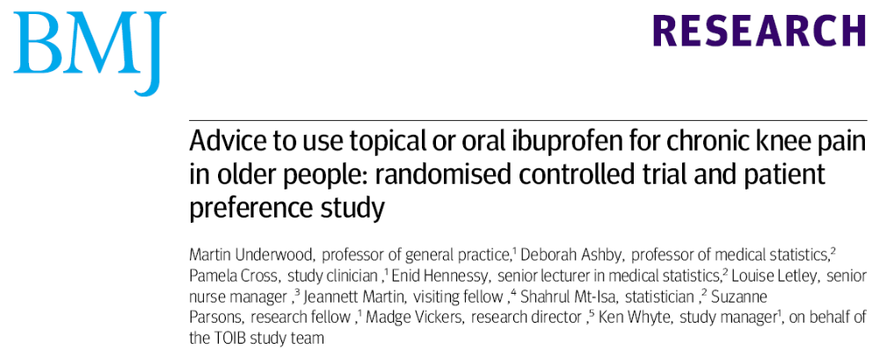
Few examples of real equivalence
BMJ 2008;336:138-142

Slide 8
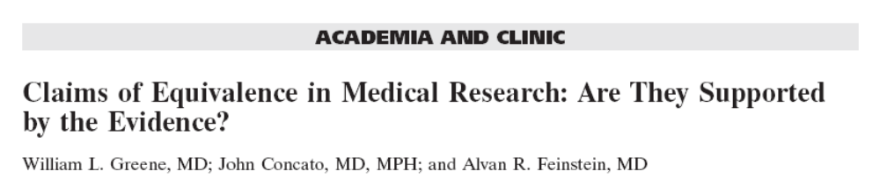

Often not!

Slide 9
Why do we not all agree on an appropriate margin?
Various reasons
  We work in different therapeutic areas
    (hence, let’s “not consider a model…”)
  We have different reasons to be interested in trials (and treatments)
    Patients, purchasers, and many in between and off at tangents

Slide 10
Lack of thinking???
“You have to make delta half the difference between standard and placebo – anything else just makes the sample size impossible”

Slide 11
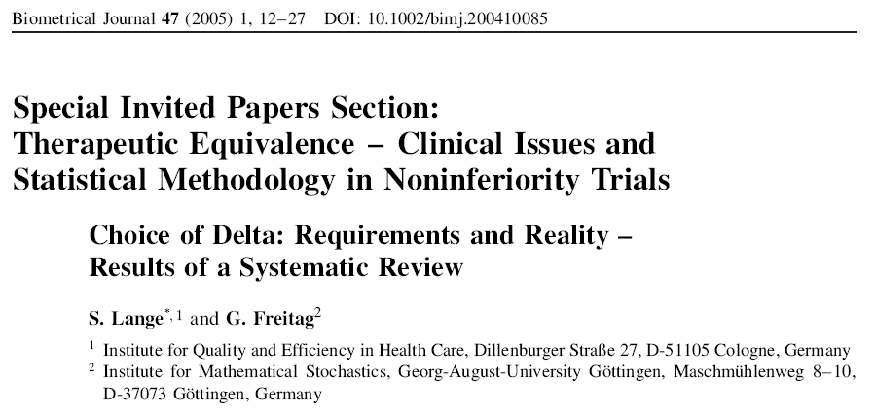
Current practice

Slide 12
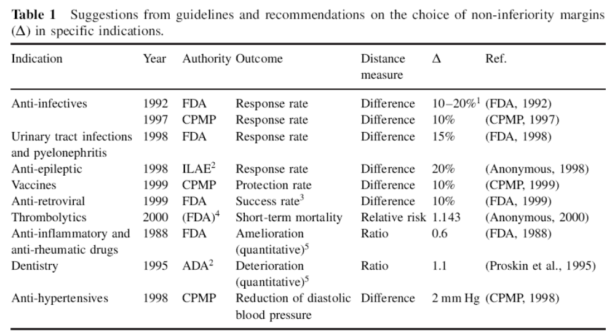

Slide 13
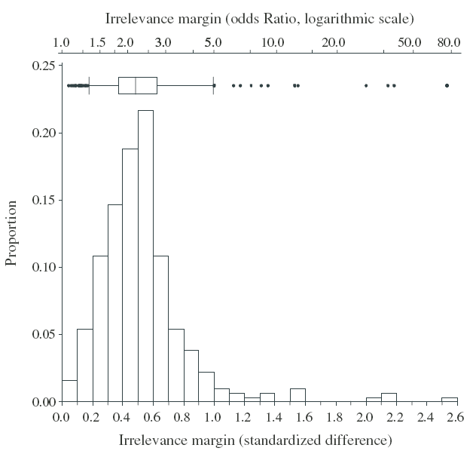
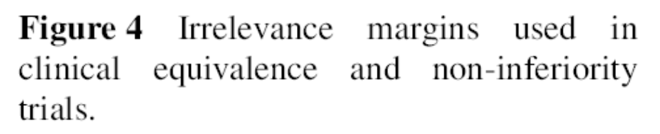
[n = 332]

Slide 14
Different uses for such studies
Some to show two products yield materially similar results
  Needs a narrow margin
Some to show a treatment is better than (putative) placebo
  A wide margin may answer this question
  (but still not make the product very prescribable)
Some maybe both

Slide 15
What makes a margin acceptable?
The results of the study!
Treatment choices are based on benefit–risk
In a superiority study we cannot say, a priori, what size of benefit will be prescribable
EU regulators rarely (if ever) fully agree to a margin – it’s always conditional

Slide 16
Margins depend on results
DVT rates following surgery, about 15%
NI margin argued to be 2 percentage points
Trial results: 4% DVT versus 5% DVT
  Unlikely to be accepted

Slide 17
Margins depend on results
Possibly argue Δ₁, if overall event rate π₀
  Then Δ₂ (> Δ₁) if π > π ₀
  And Δ₃ (< Δ₁) if π < π ₀
Concept of “equivalent differences”
Statistics in Medicine, 1988; 7: 1187–1194.
Others have argued for similar ideas (successfully, over a narrow, plausible, range of π)

Slide 18
Margins depend on consumers
How much are you prepared to pay?
What access to medicines do you have?
What side effects are you prepared to tolerate?
What’s your prior?

Slide 19
Licenses don’t depend on p<0.05
In a superiority study, getting p<0.05 does not imply automatic grant of an MA
In a superiority study, getting p>0.05 does not imply automatic failure to grant an MA
Instead, regulators look at the data (all of it!)

Slide 20
Licenses don’t depend on p<0.05
In a non-inferiority study, getting p<0.05 (against some non-zero margin) does not imply automatic grant of an MA
In a non-inferiority study, getting p>0.05 (against some non-zero margin) does not imply automatic failure to grant an MA
Instead, regulators (should) look at the data (all of it!)
  And I think they do!

Slide 21
Some Conclusions
Different people cannot agree on what a reasonable margin should be
Different people cannot agree on what the principles of defining a margin should
The acceptability of a margin depends on the results
Licensure/prescribability does not equate to p<0.05 (versus zero or versus “minus something”)
Margins might be helpful for planning purposes but are much less relevant after the study

